Slide 1
U.S. Incarceration, Exoneration, and Politics by the Numbers

Slide 2
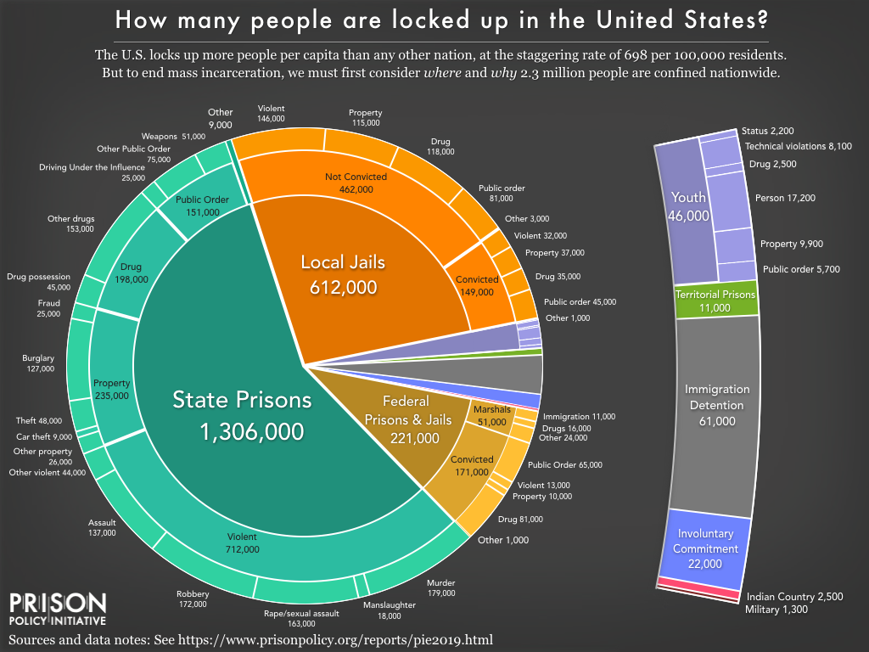
Why examine prison statistics?

Slide 3
Information Obscured, Data Wrangled
Some common problems include:
Nonstandard terminology and labels
Differing methodologies and units of measurement
Disparate recording periods
Obfuscatory data retention (and non-retention) practices
Immense scope of the subject matter
We aggregated data from the Bureau of Justice Statistics, the ProPublica Congress API, and the National Institute of Justice research on exonerations for crimes to begin to explore some of the relationships between the data and the criminal justice system.

Slide 4
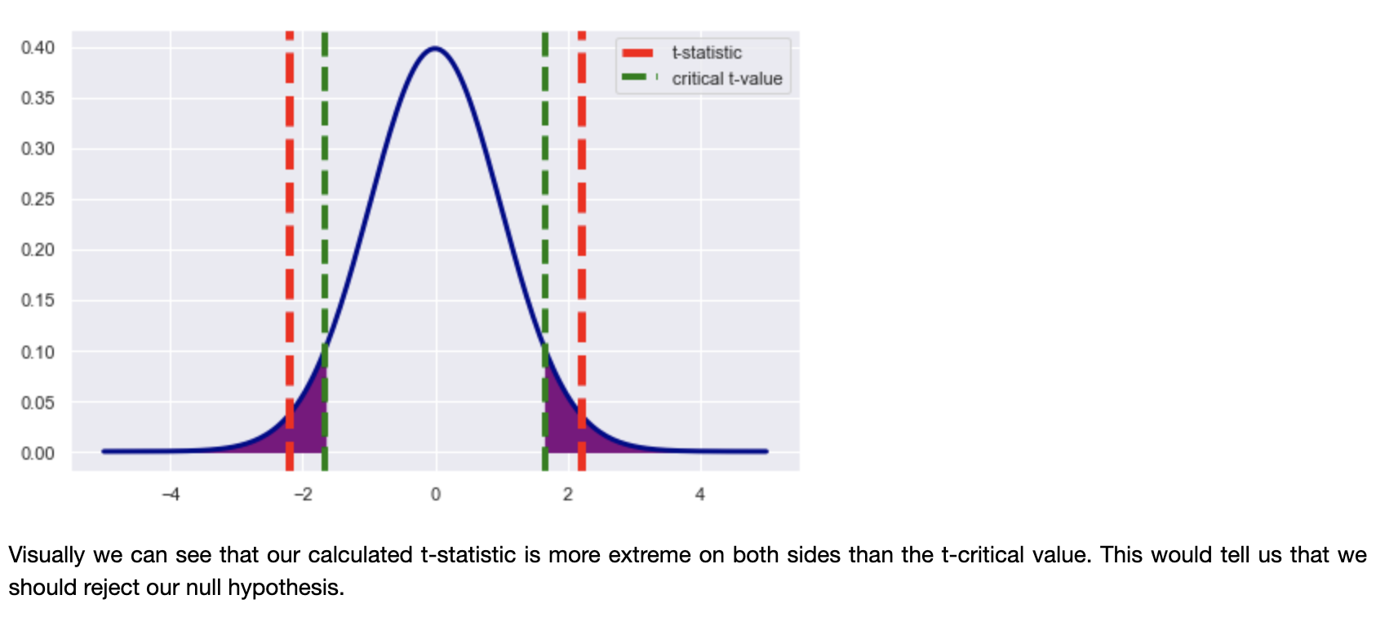
Hypothesis 1: The mean prison population has increased from 2012 to 2016

Slide 5
Hypothesis 2: The incarcerated population differs according to the state’s Senators’ party affiliation
Method: ANOVA
Findings: For the 114th Congress,
F value = 2.81
p value = 0.07
Result: Cannot reject null hypothesis. Further data collection warranted to increase power of hypothesis test.
Use both multiple Congresses and political valence (to increase observations and therefore power)
Repeated measures ANOVA (because prison population is expected to be similar over time)

Slide 6
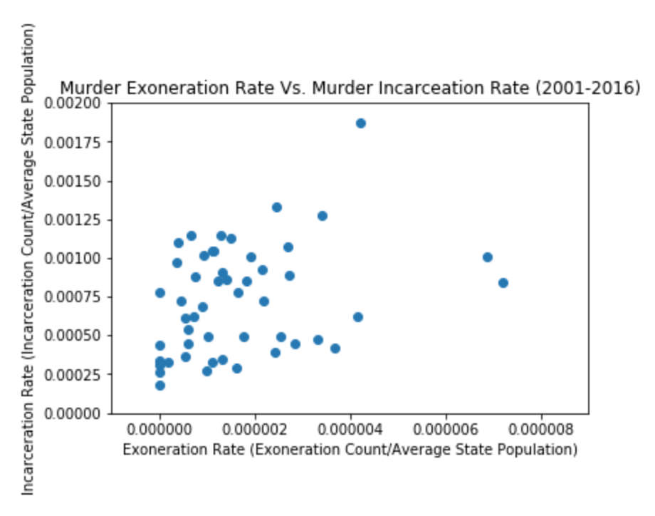
Hypothesis 3: The exoneration rate for murder correlates with the rate of incarceration for murder

Slide 7
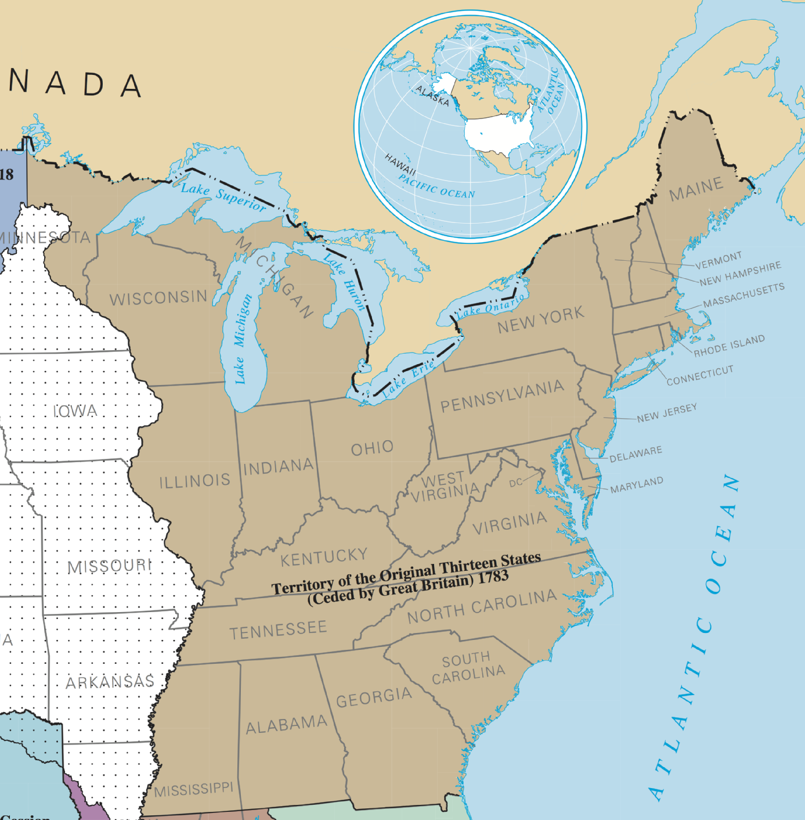
Hypothesis 4: Eastern states have a lower rate of exonerations than Western states

Slide 8
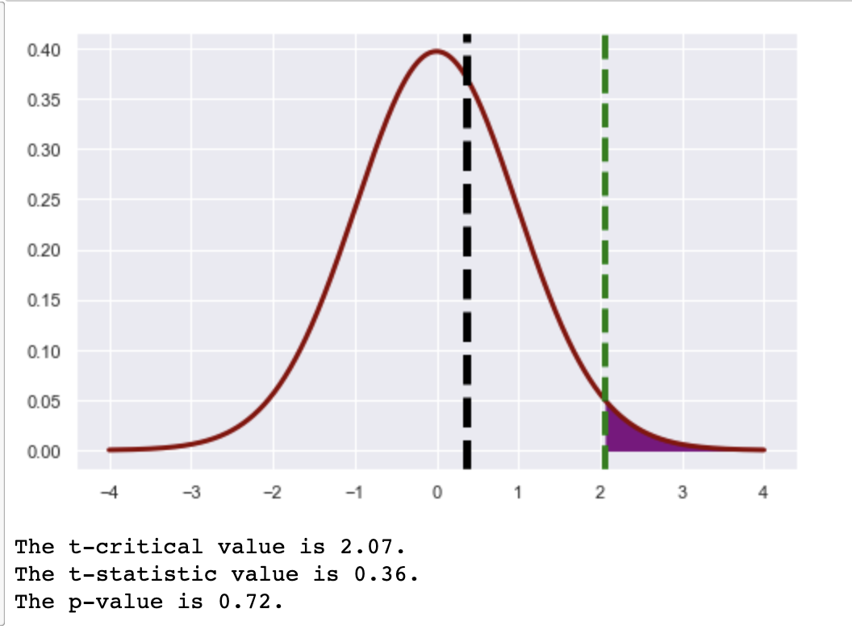

Slide 9
Takeaways
The data on incarcerated and supervised people are messy, widely-dispersed, inconsistent, and difficult to piece together -- whether unintentionally (e.g., because of the number of institutions involved in the multi-jurisdictional federal system) or by design.
The political leanings of a state’s most influential politicians warrants further investigation as a potential factor in the U.S.’s high rates of incarceration.
Crude measures of geography alone do not predict overall exoneration rates, which makes sense post hoc in that many different innocence commissions, governmental committees, and nongovernmental organizations have been formed in disparate jurisdictions to investigate wrongful conviction (probably more closely aligned with political will than with physical location). Doing one’s homework on domain knowledge really matters here.

